Slide 1
Highway Safety Manual at the Project Level
Partnering Conference 2016
Eric Green, MSCE, PE
Kentucky Transportation Center
Mike Vaughn
Kentucky Transportation Cabinet

Slide 2
Would you expect these alternatives to perform the same over a 30-yr project life?
CAN we know the differences in safety performance for these alternatives before investing millions of taxpayer dollars?
Should we know the differences in safety performance for these alternatives before investing millions of taxpayer dollars?
Notes:
This first slide contains a couple typical section alternatives for a 2 Lane reconstruction project. The two questions are a bit rhetorical. I’m sure each of you would answer “NO” to the first question.
But, the second question is a bit trickier. Obviously, we “SHOULD” know the differences in safety for these two alternatives, but maybe the question should really be:
“CAN” we know the differences in safety for these alternatives?
I’ll answer that in just a few slides.

Slide 3
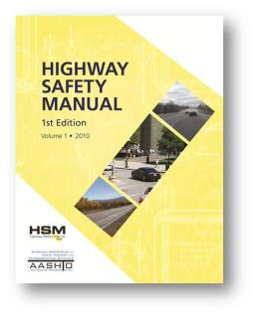
Incorporating Safety at the Project Level
“Road safety management is in transition. The transition is from action based on experience, intuition, judgment, and tradition, to action based on empirical evidence, science, and technology…”
Notes:
Before I go any further, I wanted to share this quote. I saw this about a year ago. It was in a presentation being given by Jerry Roche, a Safety Engineer with FHWA. This quote basically says that we are changing how we manage safety on our roadways. But what does this really mean?

Slide 4
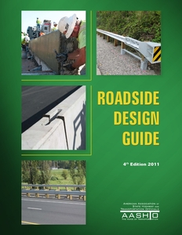


Approaches for Considering Safety
Nominal Safety
Substantive Safety
Source: AASHTO
Examined in reference to compliance with standards, warrants, guidelines, and traditional design procedures
The expected performance of a roadway in terms of crash frequency and severity
Source: AASHTO
Notes:
Let’s consider how roadway safety can be approached.
The way we’ve been approaching safety for years and years is by using resources such as the Green Book and the Roadside Design Guide. As you know these books contain common standards and guidelines. We follow these standards, almost religiously, with the expectation that the roadway we’re designing will be “Safe” because it meets the standards within these books.
This is known as ‘nominal safety’.
There is a newer approach to evaluating safety called ‘substantive safety’. Many states are beginning to transitioning to this approach to safety. That’s what the quote on the previous slide was referring to. This approach uses a variety of analytical models found in the Highway Safety Manual that can quantify the safety performance of a given roadway.
The analytical models found in the HSM are based on years of national research where various roadway characteristics were compared to historical crash data.
One question some may have is: Doesn’t either approach lead to the same results?
In some cases, both approaches may lead you to making the same decision, but in other cases they may not.
Why is that?

Slide 5
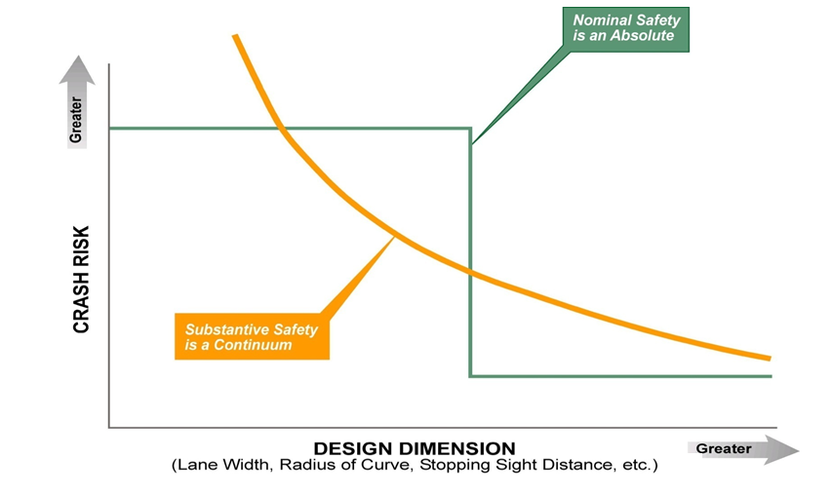
Nominal vs. Substantive Safety
Nominal Safety
Substantive Safety
5
Notes:
5
I think a graph is the best way to show the difference between Nominal and Substantive safety.
Let’s think of safety as “Crash Risk” and put it on the Y-Axis. We’ll place the “Design” of a Highway on the X-Axis; this would be elements such as Lane Width, Radius of Curve, and Stopping Sight Distance.
Based on the guidelines in the Green Book, a roadway either meets standards or it doesn’t. If it meets standards it’s considered to have lower crash risk; if does not meet standards, then it’s considered to have higher crash risk.
Plotting that would look like the green line.
But, is this really a good representation or model of crash risk?….No.
A more accurate model of crash risk would be the orange line, because Safety is really a continuum that depends on a variety of factors.
The HSM provides the analytical models that predict safety performance in this way.
Now, don’t get me wrong. I’m not saying that Nominal Safety is necessarily a bad way of approaching safety for our highway projects. Look at the interstate system for example…interstate routes have some of the best safety performance of all roads.
But, we can’t always build an interstate. These days a huge factor in our decision making is cost…we have less funding now than we’ve ever had, so we are having to come up with more practical solutions. The idea of practical solutions isn’t anything new, but until the HSM was developed, we really haven’t had a way of analyzing the safety differences between a practical solution and a green book solution.

Slide 6
Should we know the differences in safety performance for these alternatives before investing millions of taxpayer dollars?
CAN we know the differences in safety performance for these alternatives before investing millions of taxpayer dollars?
YES!!
Notes:
Which brings me back to my first slide. We can think of the typical section on top as the Green Book solution, and the typical section on the bottom as the Practical Solution.
And for the question I said I would answer: Can we know the differences in safety of these two alternatives? The answer is: YES…we have the Highway Safety Manual.
Going a little further: Should we know the differences in safety? YES!
Quite frankly, because the Highway Safety Manual gives us the tools to know the safety differences of these alternatives, then we SHOULD be using those tools to quantify those differences.
I’ll jump off my soap box, and turn it over to Eric. He’s going to go into further detail on some of the tools within the Highway Safety Manual.

Slide 7
Highway Safety Manual
Project Level
Eric Green

Slide 8
Decision Making Process
Environment
Safety
Society
Right of Way
Costs
Capacity
Notes:
Until recently, transportation professionals did not have a single national resource to use in estimating safety performance. The HSM provides professionals with a much needed resource where current knowledge, techniques, and methodologies to estimate future crash frequency and severity are presented. Professional now have a set of predictive methodologies that can use in predicting crashes and quantitatively evaluate alternative designs. The new methods in the HSM are more statistically rigorous and reduce past issues of random variations of crash data.

Slide 9
Basic Safety Questions?
How can I predict safety performance of geometric design features?
How can I quantitatively calculate safety effects?
How can I justify decisions based on safety implications?
Notes:
The HSM can answer these questions by:
Providing proven and vetted science-based approach to quantifying safety effects of decisions and actions a professional contemplates
Providing common knowledge base, language and basis for reasoned safety judgments
Allowing incorporation of safety to same level of importance as other factors
Not increasing risk of tort liability

Slide 10
Highway Safety Manual Purpose
Resource for professionals
Safety knowledge
Decision making tools
Notes:
Purpose of the HSM
The Highway Safety Manual (HSM) is a resource that provides safety knowledge and tools in a useful form to facilitate improved decision making based on safety performance. The focus of the HSM is to provide quantitative information for decision making. The HSM assembles currently available information and methodologies on measuring, estimating and evaluating roadways in terms of crash frequency (number of crashes per year) and crash severity (level of injuries due to crashes). The HSM presents tools and methodologies for consideration of “safety” across the range of highway activities: planning, programming, project development, construction, operations, and maintenance. The purpose is to convey present knowledge regarding highway safety information for use by a broad array of transportation professionals.

Slide 11
A Safe Roadway?
List what are the top three items that make a roadway safe
Notes:
Provide your answer here:
1.
2.
3.

Slide 12
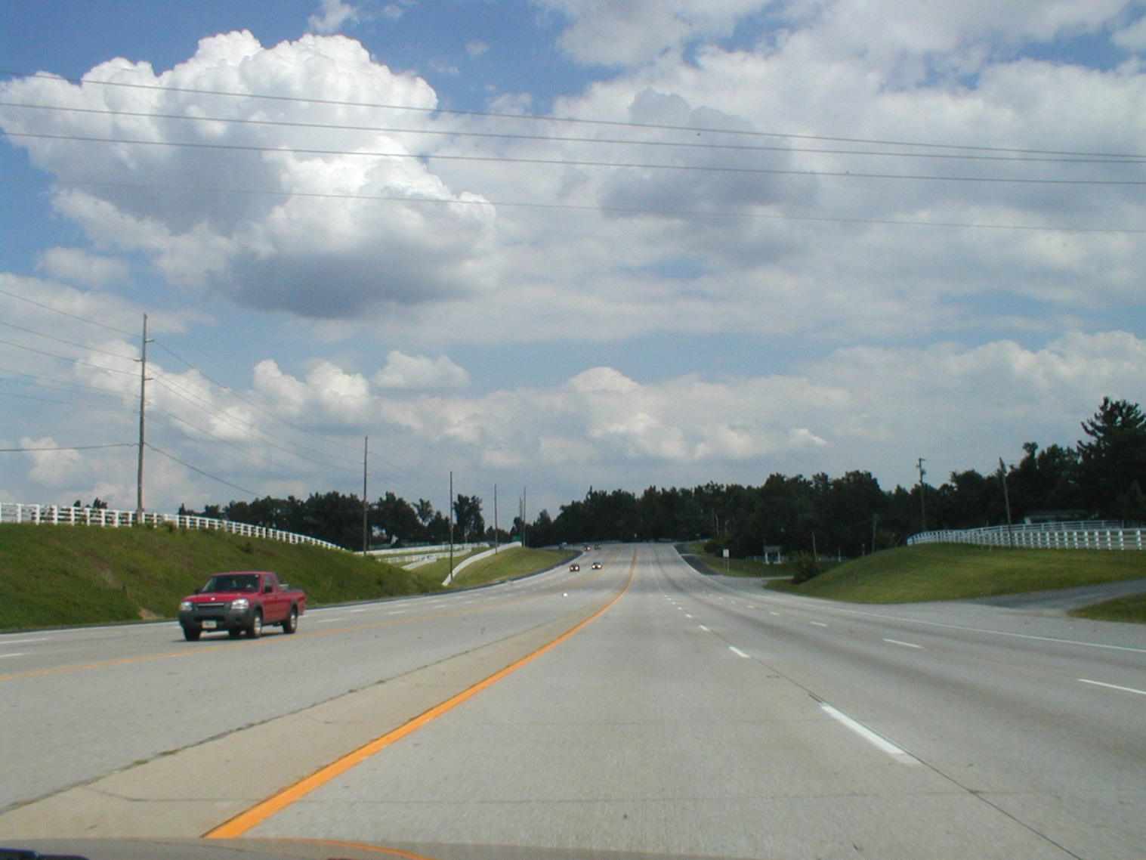
Safe Roadway?

Slide 13
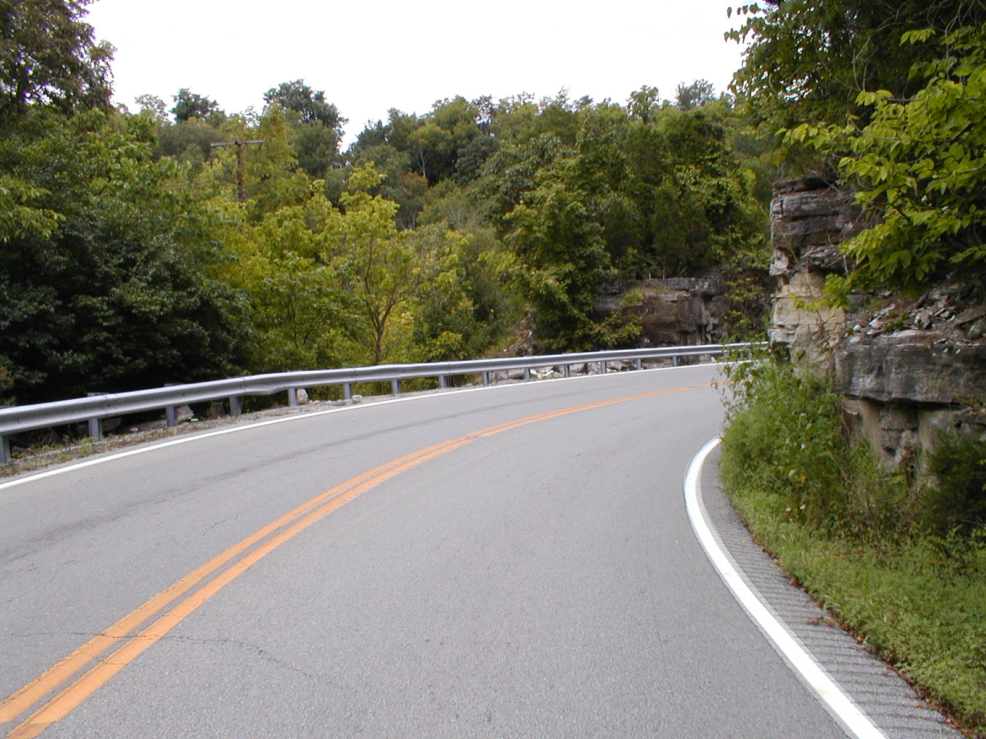
Safe Roadway?

Slide 14
Crash Prediction Uses
Program level
  Segment prioritization
Project level
  Project needs assessment
  Communication with the public
  Documentation
Tort Defense

Slide 15
HSM Contents
HSM
Part A
Part B
Part C
Part D
Introduction, Human Factors, Fundamentals
Safety Management Process
Predictive Methods
Crash Modification Factors
Notes:
The HSM is divided into four parts. In part A the user is provided with an introduction to the HSM, knowledge about human factors and the fundamentals of highway safety. Part B covers the roadway safety management process. In Part C predictive methods are introduced for different facility types. And, last but not least, Part D provides Crash Modification Factors (CMFs) for use with Part B. It is important to keep in mind that Part D can only be used with Part B – Part C has its own AMFs for each facility type. This issue is further addressed later in the presentations.
The first edition does not cover driver education, enforcement, and vehicle safety, even though it is recognized that these are important elements which can help reduce injuries and fatalities from motor vehicle crashes.

Slide 16
Some More Questions
What is the number of crashes for a given scenario?
  2-lane rural road with 5,000 AADT
  4-lane rural divided arterial with 20,000 AADT
What will be the safety effect if we
  Widen shoulder
  Add a median
  Add a left-turn lane
Notes:
The goal in this process is to be able to quantify the anticipated crashes for any given scenario. This is the critical question that any person involved in any stage of the project development process is trying to address. The answer will provide quantifiable results and allow to decisions to be made through a well-documented process.

Slide 17
How HSM Works
Predicted
Crashes
SPF
CMF
C
Safety Performance Function(SPF): regression equation
Crash Modification Factor (CMF): adjustment factors
Calibration Factor (C): local adjustment
Notes:
The predicted crashes are the “expected average number of crashes”. The use of the SPF indicates the application of a statistical method and the answer is not an exact number, as is frequently the case in engineering, but rather a statistical
estimate. This means that if we record crashes in several sites with similar characteristics, then, on average, we can expect to measure that particular number.

Slide 18
Part C: Predictive Methods (1/3)
SPF
Safety Performance Functions (SPFs)
  Regression models
  Predict expected crash frequency
Developed from data for a number of similar sites
Developed for specific site types and “base conditions”
Notes:
SPFs are regression models that are developed using historical data from a set of sites with similar characteristics. Sites can be aggregated based on lane width, shoulder width and type, degree of curvature, presence of median or any other geometric features that could provide for such classification.
The model developed could predict the expected number of crashes for these sites and can be used to estimate crash performance for sites with similar features. The models establish the base conditions based on the common features of the sites used in the prediction. The models are typically a function of ADT.

Slide 19
SPF Development
SPF
Crashes/Year
Average Daily Traffic (ADT)
Notes:
Here is an example of how an SPF can be developed.
Assuming that the four data sets depict the crash experience over 5 years for a set of sites with similar features. It can be assumed that the all sites are 2-lane roads with 12-foot lanes, 8-foot shoulders, and no curves.
A curve is fitted through these 4 entities using a negative binomial regression formula. The line is the “best fit” of all the data and is the Safety Performance Function (SPF). The line represents the change in the mean expected number of crashes at all similar entities as ADT (or other exposure measure) increases, while all other factors affecting crash occurrence are held constant. It should be noted that this is an example and typically SPFs are based on a far greater number of sites for greater accuracy.
Sites that lie above the SPF indicate a mean expected crash frequency in excess of the average for comparable sites. One can think about sites with mean risk above the SPF as those with higher than average risk and those below the line as those with lower than average risk.
SPFs have been compiled into safety analysis tools, such as SafetyAnalyst and the Highway Safety Manual (HSM).
However, since crash patterns may vary in different geographical areas, SPFs must be calibrated to reflect local conditions (e.g., driver population, climate, crash reporting thresholds, etc.).

Slide 20
Part C: Predictive Methods (2/3)
CMF
Crash Modification Factors (CMFs)
  Adjusts SPF predicted value
  Accounts for differences between base and site specific conditions

Slide 21
Part C: Predictive Methods (3/3)
C
Local calibration factor (C_{r})
  Adjusts SPF from HSM to local conditions
  Addresses local variations
Notes:
The purpose of the calibration factors is to adjust for differences in crash frequency for the initial regions of model development to those for local conditions.
The predictive methods included in Part C of the HSM were developed with data from select jurisdictions in the United States. These Part C models include Safety Performance Functions (SPFs), Crash Modification Factors (CMFs), and Calibration factors. Variations due to climate, driver populations, animal populations, crash reporting thresholds, and crash reporting system procedures are examples of unique variations that warrant the development of region-specific calibration factors.

Slide 22
HSM Prediction Models
Prediction models for
  Homogeneous highway segments
  Intersections
Segments based on homogeneous
  Geometry
  AADT ranges
Notes:
The Analysis divides the highway into homogeneous analysis sections based on whether they are intersections or roadway segments. Each analysis section is homogenous with respect to geometry and traffic conditions.
Homogeneous highway segments have uniform horizontal, vertical, cross section, traffic characteristics, and roadside geometry. At any location where there is a change in geometry (e.g., changing from a horizontal curve to a tangent or a change in shoulder width) or a change in traffic volume, a new highway segment begins.
Each intersection is also defined as a separate, homogenous analysis section.

Slide 23
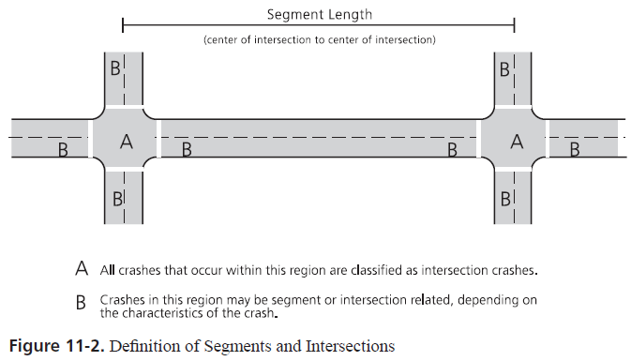
Segments and Intersections
Notes:
10.5. ROADWAY SEGMENTS AND INTERSECTIONS
Roadway segments begin at the center of an intersection and end at either the center of the next intersection or where there is a change from one homogeneous roadway segment to another homogenous segment. The roadway segment model estimates the frequency of roadway-segment-related crashes which occur in Region B in the figure above. When a roadway segment begins or ends at an intersection, the length of the roadway segment is measured from the center of the intersection.
Chapters 10, 11 and 12 (multilane) provide predictive models for stop-controlled (three- and four-leg) and signalized (four-leg) intersections. The intersection models estimate the predicted average frequency of crashes that occur within the curb line limits of an intersection (Region A of figure above) and intersection-related crashes that occur on the intersection legs (Region B in figure above).
HSM, I Vol 2 page 10-11

Slide 24
HSM Process
Define Data
Limits, Type, Time, Geometry, AADT
Segment Facility
Geometry, AADT
Predict Crashes
SPF
Adjust Crashes
CMF, C
Notes:
HSM Process
The predictive method for each facility can be summarized as shown above. The first steps involve the collection of required input data including:
• Limits of the roadway and facility type in the study;
• Period of interest;
• Geometric design features, traffic control, and site characteristics;
• Availability of traffic volume for the study period;
• For intersections, AADT volumes are needed for both the major and minor streets; and
• If the EB Method is used, AADT traffic volumes are needed for each year for which observed crash data are available.
The next step requires the segmentation of the facility into individual homogenous (or similar) roadway segments or intersections. For roadway segments, the recommended site length is equal to or greater than 0.10 miles. Smaller segments would result in excessive and needless calculations. Boundaries can be defined based on cross section, AADT, and alignment changes as well as with the presence of intersections. The HSM includes recommendations for rounding variables that then helps clarify the boundaries of homogeneous segments. This information is located on pages 10‐12 to 10‐13 (for rural two‐lane segments), pages 11‐12 to 11‐13 (for rural multilane highway segments), and page 12‐15.
The next steps involve the estimation of the predicted crashes through the SPF (by using the appropriate function for the roadway type evaluated) and the adjustment to the local conditions though the use of CMFs and the calibration factor.

Slide 25
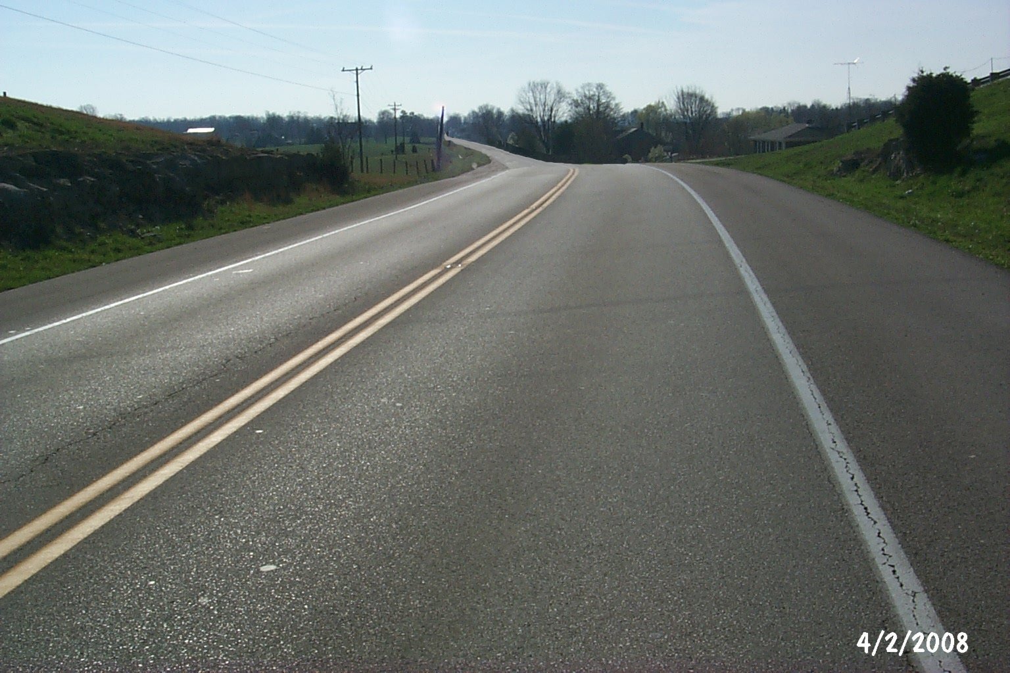
Cross Sectional Elements
Notes:
The entire cross section is of interest when one considers safety. This includes lanes and shoulders, as well as the roadside.

Slide 26
Safety and Operational Effects
Crashes Operations
Head-on Capacity
Wider is “better” Wider means “faster”
Run-off-Road Capacity
Wider is “better” Functionality
Run-off-road (severity) Maintenance
Flatter is better Flatter is better
Run-off-road Horizontal sight
(frequency and severity) distance
Lane Width
Shoulder Width
Sideslope
Clear Zone
Notes:
There are safety and operational effects for each cross sectional element. Some are positive and some are negative and there are interactions. For example wider lanes may improve safety but they encourage greater speeds, which could be impacting safety negatively.

Slide 27
HSM Crash Prediction Method
Seg.
Total Predicted
Crashes
Int.
Total predicted crashes: expected number of crashes
Int.: Expected crash frequency for all intersections
Seg.: Expected crash frequency for all roadway segments
Notes:
In general, the total number of predicted crashes for a facility will be equal to the sum of predicted crashes for roadway segments and intersections.

Slide 28
Prediction Model
N_{predicted} _{i} = N_{spf} _{i} x (CMF₁ … CMF_{x}) C_{i}
N_{predicted} _{i} = Expected crash frequency for an individual element
N_{spf} _{i} = Expected crash frequency for base conditions for an individual element
CMF_{i} = Crash Modification Factors for individual design elements
C_{i} = Calibration factor
Notes:
The equation for predicting the expected total crash frequency, N_{predicted i} on a particular homogenous highway segment, where i is a roadway segment or an intersection.
This model can be used to estimate total predicted average crash frequency (i.e., all crash severities and collision types) or can be used to predict average crash frequency of specific crash severity types or specific collision types. The predictive model for an individual element (i.e., roadway segment or intersection) combines a SPF with CMFs and a calibration factor.

Slide 29
Segment SPFs
2-lane Rural
N_{spf} _{rs} = (AADT_{n}) (L) (365) (10⁻⁶) e^{-0.312}
Multilane, Rural Undivided
N_{spf ru} = e^{(a + b} ^{Ln} ^{AADT + Ln L)}
Multilane, Rural Divided
N_{spf rd} = e^{(a + b} ^{Ln AADT + Ln L)}
Notes:
The equations shown here are for rural road segments and represent the base conditions. The equations are used to predict the expected crashes per year on individual highway segments based upon traffic volume and segment length. Each assumes the appropriate base conditions for geometric and traffic control elements, which are discussed next.
For 2-lane roads, the only inputs to the base model are traffic volume and segment length. For the multilane roads, the parameters a and b are defined based on the type of crash severity predicted, i.e., they are different for total and fatal and injury predictions. These values are defined in Tables 11-3 and 11-5 for undivided and divided segments, respectively.
Each equation has a usable range of AADT that is based on the data utilized to develop the models. For example, the SPFs for roadway segments on 2-lane rural roads are applicable to the AADT range from zero to 17,800 vehicles per day. Application to sites with AADTs substantially outside this range may not provide reliable results.

Slide 30
Base Conditions: 2-Lane Rural
Lane Width: 12 feet
Shoulder Width: 6 feet
Shoulder Type: Paved
Roadside Hazard Rating: 3
Driveway Density: <5 driveways/mi
Grade: <3%(abs)
Horizontal Curvature: None
Vertical Curvature: None
Centerline rumble strips: None
TWLTL, climbing, or passing lanes: None
Lighting: None
Automated Enforcement: None
Notes:
These are considered the nominal geometry or base conditions represented by the base model.
It should be emphasized that the values shown here do NOT represent the “safest” values. The reason for selecting these dimensions as the base conditions is statistical. These values are the approximate the mean values for these variables in the database used to fit the base model. This implies for example, that the average lane width for the database used to develop the model is approximately 12 feet. Moreover, the regression models developed have the least standard error near the mean values of these independent variables in the model.

Slide 31
Base Conditions: Multilane Roads
All
  Lane width 12 feet
  Shoulder type Paved
  No lighting or automated speed enforcement
Undivided
  Shoulder width 6 feet
  Sideslopes 1V:7H or flatter
Divided
  Shoulder width 8 feet
  Median 30 feet
Notes:
The same notes apply for these values regarding the reason for the selection of the values. An additional note is that the shoulder width used for both divided and undivided is that of the RIGHT shoulder.

Slide 32
SPF Application Example
2-Lane road with AADT = 3,500 vpd and 2 miles long
N_{spf} _{rs} = (AADT_{n}) (L) (365) (10⁻⁶) e^{-0.312} =
Notes:
Example calculation using the SPF base model for 2-lane rural highway segments. Note that the estimate is the number of crashes per year. It is assumed that the segment geometry complies with the base conditions.

Slide 33
Deviating from Base Conditions
Use of CMFs
N_{predicted i} = N_{spf} _{i} x (CMF₁ … CMF_{x})
NOTE: for 2-lane rural roads a calibration factor (C_{r}) is also used
Notes:
Most times the base conditions will not reflect the actual roadway geometry. In this case, the next step involves the use of the appropriate Crash Modification Factors to the predicted crash frequency in order to account for those conditions that are different that the assumed base conditions.
This model estimates the predicted average crash frequency of non-intersection related crashes (i.e., crashes that would occur regardless of the presence of an intersection).
CMFs are used to adjust the SPF estimate of predicted average crash frequency for the effect of individual geometric design and traffic control features. The CMF for the SPF base condition of each geometric design or traffic control feature has a value of 1.00. Any feature associated with higher crash frequency than the base condition has a CMF with a value greater than 1.00. Likewise, any feature associated with lower crash frequency than the base condition has a CMF with a value less than 1.00.

Slide 34
CMF Notes
Values from tables
  Similar to HCM
Some require adjustment
  Computed for specific crash types
Need to ensure crash distribution
The effect of application of multiple CMFs is multiplicative, not additive
Notes:
For most CMFs, the values are simply taken from the corresponding tables. Attention should be paid to those that vary by AADT, since different values are used in this case.
The CMFs presented in the tables are for the specific crash types associated for the element adjusted. For example, when computing the CMF for lane width, the associated crashes are single-vehicle run-off the-road and multiple-vehicle head-on, opposite-direction sideswipe, and same-direction sideswipe crashes. This default crash type distribution, and therefore the value of the percent of associated crashes, may be updated from local data as part of the calibration process.

Slide 35
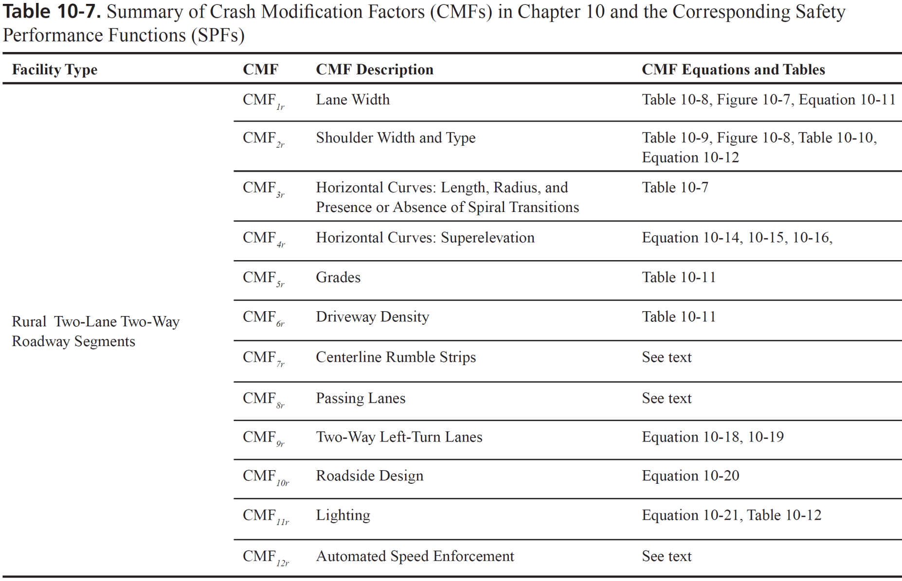
2-Lane Rural Segment CMFs
Notes:
Here is an example of how CMFs are determined to estimate the effect of deviating from the base conditions. Similar tables are available for all road types and both segments and intersections.

Slide 36
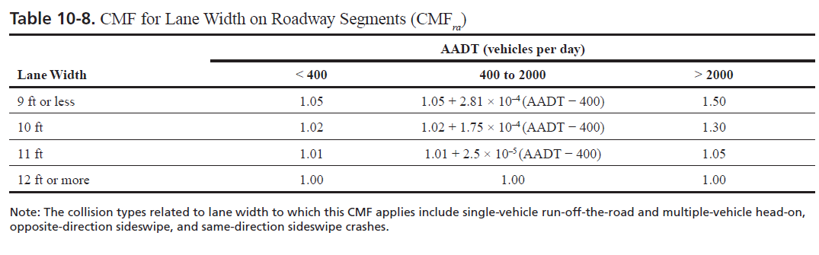
CMF Example Calculation (1/5)
CMF_{1r} = (CMF_{ra} – 1.0)p_{ra} + 1.0 Eq. 10-11
Notes:
In this example, the CMF for 2-lane rural roads is presented. It should be noted that the CMFs shown in Table 10-8 apply only to the crash types that are most likely to be affected by lane width: single-vehicle run-off-the-road and multiple-vehicle head-on, opposite-direction sideswipe, and same-direction sideswipe crashes. These are the only crash types assumed to be affected by variation in lane width, and other crash types are assumed to remain unchanged due to the lane width variation.
CMF_{ra} = crash modification factor for the effect of lane width on related crashes (i.e., single-vehicle run-off-the road and multiple-vehicle head-on, opposite-direction sideswipe, and same-direction sideswipe crashes), such as the crash modification factor for lane width shown in Table 10-8; and
p_{ra} = proportion of total crashes constituted by related crashes.
The proportion of related crashes, p_{ra}, (i.e., single-vehicle run-off-the-road, and multiple-vehicle head-on, opposite direction sideswipe, and same-direction sideswipes crashes) is estimated as 0.574 (i.e., 57.4 percent) based on the default distribution of crash types presented in Table 10-4. This default crash type distribution, and therefore the value of p_{ra}, may be updated from local data as part of the calibration process.

Slide 37
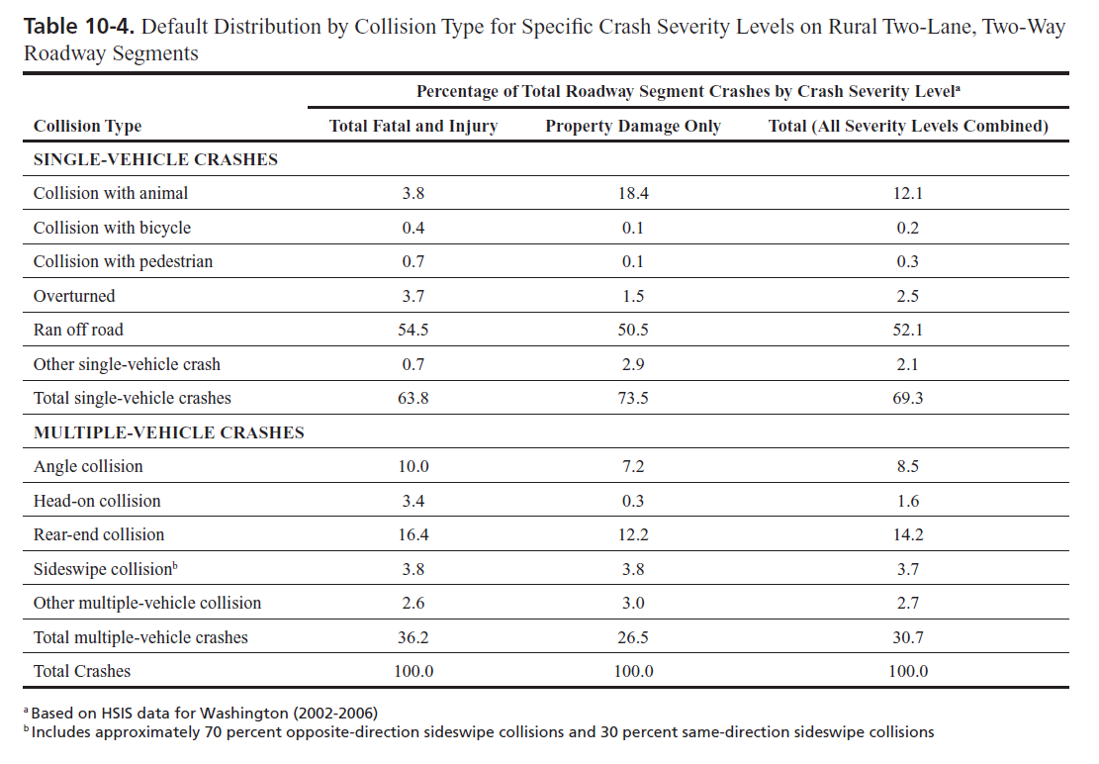
Crash Distribution

Slide 38
CMF Example Calculation (2/5)
AADT 3,500 vpd; Lane width 11 feet
CMF_{1r} = (CMF_{ra} - 1.0) p_{ra} + 1.0 =
Notes:
Example calculation on determining an CMF_{1r} for Lane Width for total crashes when the CMF_{ra} is given for a particular crash type or severity level.
Here CMF_{ra} is for crash types relating to ROR, Head-On and Sideswipe Crashes.

Slide 39
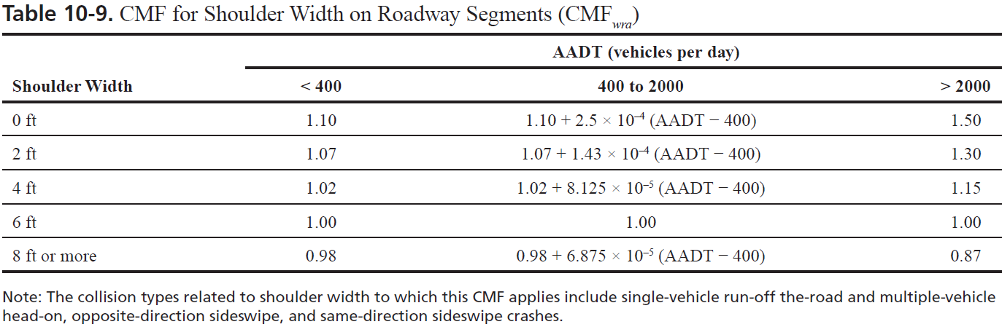
CMF Example Calculation (3/5)
CMF_{2r} = (CMF_{wra} CMF_{tra}– 1.0)p_{ra} + 1.0
Notes:
The CMF for 2-lane rural road shoulder is presented here. This CMF accounts for the shoulder width (CMF_{wra}) and the shoulder type (CMF_{tra}). The base value of shoulder width and type is a 6-foot paved shoulder, which is assigned a CMF value of 1.00.
It should be noted that the values in Table 10-8 are only for shoulder related crashes: single-vehicle run-off the-road and multiple-vehicle head-on, opposite-direction sideswipe, and same-direction sideswipe crashes.

Slide 40
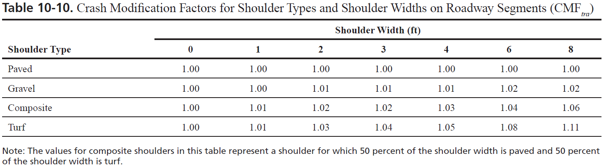
CMF Example Calculation (4/5)
Notes:
This table shows the effect of the shoulder type and estimates the CMF_{tra} which adjusts for the safety effects of gravel, turf, and composite shoulders as a function of shoulder width.
If the shoulder types and/or widths for the two directions of a roadway segment differ, the CMF are determined separately for the shoulder type and width in each direction of travel and the resulting CMFs are then be averaged.

Slide 41
CMF Example Calculation (5/5)
AADT 3,500 vpd; 4 foot turf shoulder
CMF_{2r} = (CMF_{wra} CMF_{tra}– 1.0)p_{ra} + 1.0 =
Notes:
Example calculation on determining an CMF_{2r} for Shoulder Width and Type for total crashes when the CMF_{wra} and CMF_{tra} are given for a particular crash type or severity level.
Here CMF_{wra} and CMF_{tra} are for crash types relating to ROR, Head-On and Sideswipe Crashes.

Slide 42
Application of CMFs
N_{predicted i} = N_{spf} _{i} x (CMF₁ … CMF_{x})
AADT 3,500, Length 2 miles, 11-foot lanes, and 4-foot turf shoulder
N_{predicted rs} = (1.87)(1.03)(1.12) =
2.15 crashes per year
Notes:
As previously noted, the CMFs are used to adjust the base model SPF to the local conditions. In this case, they are used as multiplies to adjust the predicted number of crashes to existing conditions.

Slide 43
Crash Modification Factors
All crashes or some types/severity
Part C
  From SPF development
Part D
  Independent research
  Countermeasures
Number of CMFs at once
Notes:
It should be noted that CMFs may be applicable to all crash types or certain types and/or severity. Caution should be exercised when using them.
Another notable difference is the use of CMFs in Part C and Part D. Part C CMFs were developed in conjunction with the model development whereas Part D CMFs are based on actual countermeasures. The CMFs from Part D can be used to adjust the SPFs used from Part C.
The user needs to be aware of the fact that using several CMFs simultaneously is not recommended due to the potential interactions among CMFs.

Slide 44
Project Level
Design element safety prediction
  Use of adjusted SPFs
  Use of CMFs
Cost-benefit justification
  Estimate crash costs
  Compare with construction costs

Slide 45
Example #1

Slide 46
Example (1/5)
AADT 3,500, 2 mile length, 11-foot lanes and 4-foot turf shoulder
Improvement options
12-foot lanes
Pave shoulder
Notes:
This example presents the use of the HSM methods to evaluate project level decisions. There are two alternative improvement options for the roadway in concern and the decision maker needs to define the one that is more appropriate.

Slide 47
Example – Option 1 (2/5)
  New CMF_{1r} = (CMF_{ra} – 1.0)p_{ra} + 1.0 =
Notes:
The first step in evaluating each option is to determine the appropriate CMF assuming that only the specific option will be applied. In this case, the new CMF is calculated for the lane width adjustment and the difference between the two CMFs is used to determine the potential safety effect from the option.

Slide 48
Example – Option 2 (3/5)
  CMF_{2r} = (CMF_{wra} CMF_{tra}– 1.0)p_{ra} + 1.0 =

Slide 49
Example (4/5)
Anticipated crash reductions
  Option 1 3%
  Option 2 4%
Crash predictions
  N_{o}= (1.87)(1.03)(1.12) = 2.15
  N₁= (1.87)(1.00)(1.12) = 2.09
  N₂= (1.87)(1.03)(1.08) = 2.09
Which one to use?
Notes:
The decision maker has the required data to select the option to implement. In this case, both alternative options will result in similar safety gains and therefore, one may need to consider the associated costs for each option to determine the most beneficial application. The predicted number of crashes is per mile per year and they are the total number of crashes anticipated in the segment.

Slide 50
Example (5/5)
Estimated costs
  Option 1 $100,000/mile 10 years
  Option 2 $250,000/mile 20 years
Cost per crash reduced
  C₁= 100000/[(2.15-2.09)(10)] = $166,478
  C₂= 250000/[(2.15-2.09)(20)] = $196,857
Notes:
The costs for each option were obtained from the KYTC databases. The cost per option is estimated and this can assist the decision maker to select the option to implement based on both crash reductions and costs per crash reduced.
It should be noted that a simplistic approach was undertaken here to estimate the costs for the life time of the project. In this case, the lane widening will be for 10years while the shoulder paving will be for 20 years and this difference should be accounted for. A more detailed analysis using Present Worth Value and estimated interests for the life of the project should be underatken.

Slide 51
Cost-Benefit Analysis
Treatment may
  Affect severity
  Not affect number of crashes
Need to estimate crash savings over project lifetime
Cost-Benefit can assist
Notes:
It is possible that a specific treatment aimed to improve safety may not reduce the total number of crashes but have an effect on the crash severity distribution. For example, the installation of a median cable barrier will not reduce the number of run off the road crashes but it will reduce the number of sever crashes. In this case, the cost-benefit analysis will account for the estimated monetary benefits of reduced sever crashes and allow for a more appropriate estimation of the potential gains.
Another issue of concern is that benefits need to be considered over the lifetime of the project and their value should be converted to their net present value using appropriate methods.

Slide 52
FHWA Costs per Crash
Fatal $4,008,900
Injury A $216,000
Injury B $79,000
Injury C $44,900
PDO $7,400
Source: HSM 2010
Notes:
FHWA has developed associated comprehensive costs for each severity level and those are shown above. The values can be used to estimate the average crash cost based on the severity distribution of the crashes or can be used to estimate the benefits from reduction in one specific (or combination) of crash severity level(s).

Slide 53
Average Crash Cost Estimation
Crash Severity | Distribution | Cost ($) | Average Cost ($)
Fatal | 0.02 | 4,008,900 | 80,178
Injury A | 0.05 | 216,000 | 10,800
Injury B | 0.10 | 79,000 | 7,900
Injury C | 0.15 | 44,900 | 6,735
PDO | 0.68 | 7,400 | 5,032
Total | 1.00 |  | 110,645
Option 1 monetary gains: (0.06)(110645) = $6,646 per year
Notes:
In this example, the distribution of crash severity for a site is used to estimate the average crash cost for the site. Using the gains in safety by utilizing option 1 in the previous example and assuming no change in severity distribution, the annual gains per mile can be estimated. This value can be converted to the net present worth over the lifetime of he project to estimate the actual benefits from the improvement.

Slide 54
Example #2

Slide 55
Example (1/3)
Existing conditions
  AADT 18,000; 2-lane rural road; 10-foot lanes, 2-foot shoulder
Option 1
  12-foot lane; 8-foot shoulder; 2-lane road
Option 2
  12-foot lane; 8-foot shoulder; 4-lane divided

Slide 56
Example (2/3)
Condition | Crashes
Existing | 5.4
Option 1 | 2.9
Option 2 | 2.4
Costs
Option 1 $7.2 mil/mile
Option 2 $21.5 mil/mile
Notes:
These are the estimated number of crashes per mile per year for each of the alternatives considered. It is apparent that the 4-lane option will result in the larger number of crash reduction. However, one needs to consider the associated costs with each solution and determine the system wide implications.

Slide 57
Example (3/3)
Available budget $500 m to improve 2 lane roads
Cross Section | Crashes per Year | Cost (millions) | Miles
2 Lane, 10 ft L, 2 ft S | 5.4 | -- | --
2 Lane, 12 ft L, 8 ft S | 2.9 | $7.2 | 69.4
4 Lane, 12 ft L, 8 ft S | 2.4 | $21.5 | 23.3
Miles to improve w/$500 m

Slide 58
Cautions and Caveats
It’s a model
  Data quality
  Randomness
CMF effect
  Multiplicative
  Number of CMFs
  Under review and evaluation
  Crash type and severity
Judgment
  Understand strengths and weaknesses

Slide 59
Eric Green, PE
Eric.green@uky.edu
(859) 257-2680
Research Engineer
Traffic and Safety
Kentucky Transportation Center
Michael Vaughn, PE
Mike.Vaughn@ky.gov
(502) 782-4923
Highway Safety Improvement Program
Division of Traffic Operations
Kentucky Transportation Cabinet

